Slide 1

Quantitative Management Modeling Final Project
Jared Stadden
Fall 2020

Slide 2
The Problem
I have been tasked with forming 4 project groups of 3 students each in a 12 person class
The assignment of students to groups, however, needs to be done in a way that gives each group an equal chance of doing well on the project. That is, the ability and talent levels of the students should be spread equitably across the groups

Slide 3
Factors of Success
The three factors I have selected as key drivers of a student’s ability to effectively contribute to a group project are:
GPA (4.0 scale)
Relevant experience (years of experience, capped at 10)
Hours worked per week
The values of these factors for each student will be collected via a mandatory survey given to each student

Slide 4
The Approach
I have decided to solve this problem using the approach of the Transportation Problem
The students can each supply one member to a group that demands three members
The weight or cost of assignment of a student to a group will be measured by expected contribution to the project as determined by the three factors outlined previously

Slide 5
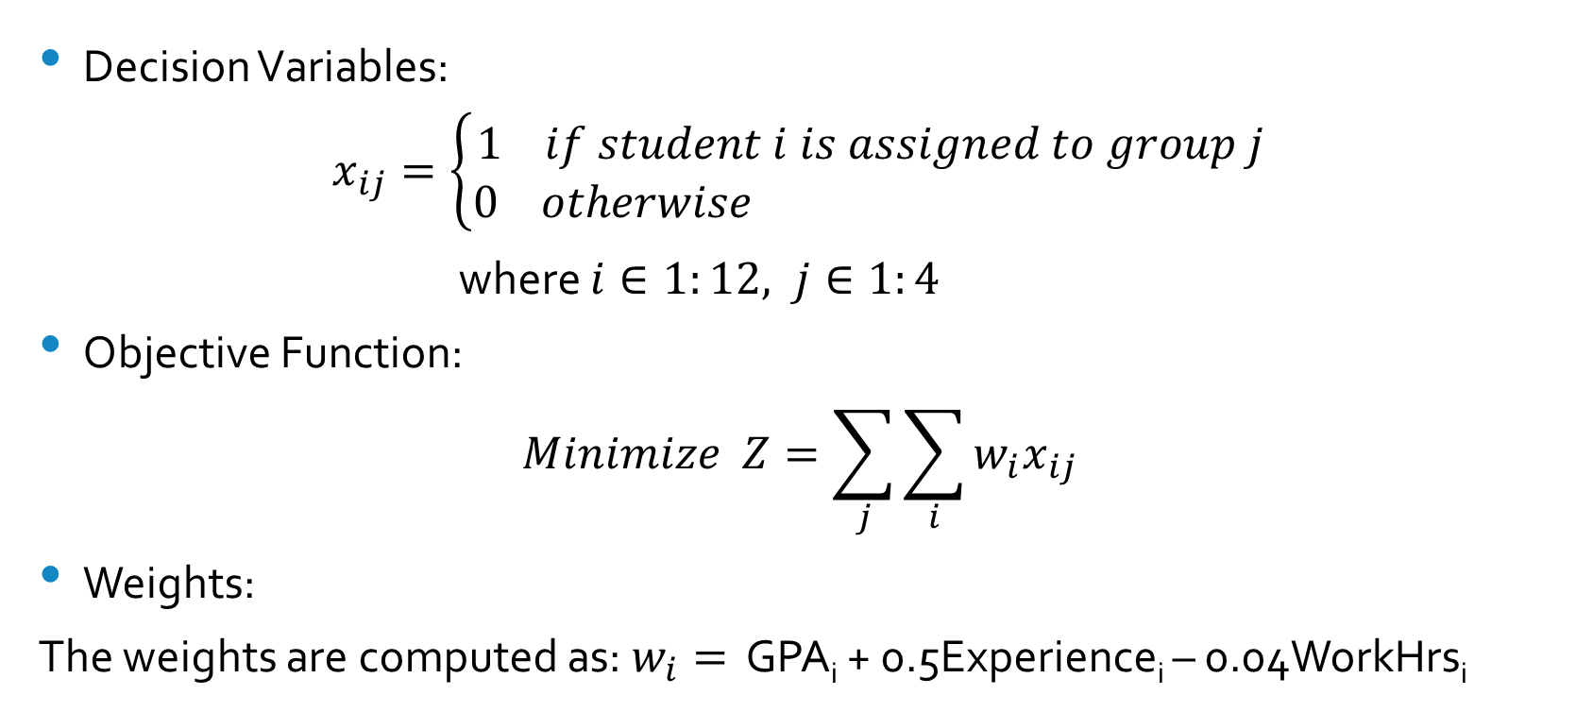
Formulation
Decision Variables:
$$x_{ij}=\left\{\begin{aligned}1 if student i is assigned to group j \\ 0 otherwise \end{aligned}\right.$$
where $i∈1:12, j∈1:4$
Objective Function:
$$Minimize Z=\sum_{j}{\sum_{i}{w_{i}x_{ij}}}$$
Weights:
The weights are computed as: $w_{i}=$ GPA_{i} + 0.5Experience_{i} – 0.04WorkHrs_{i}

Slide 6
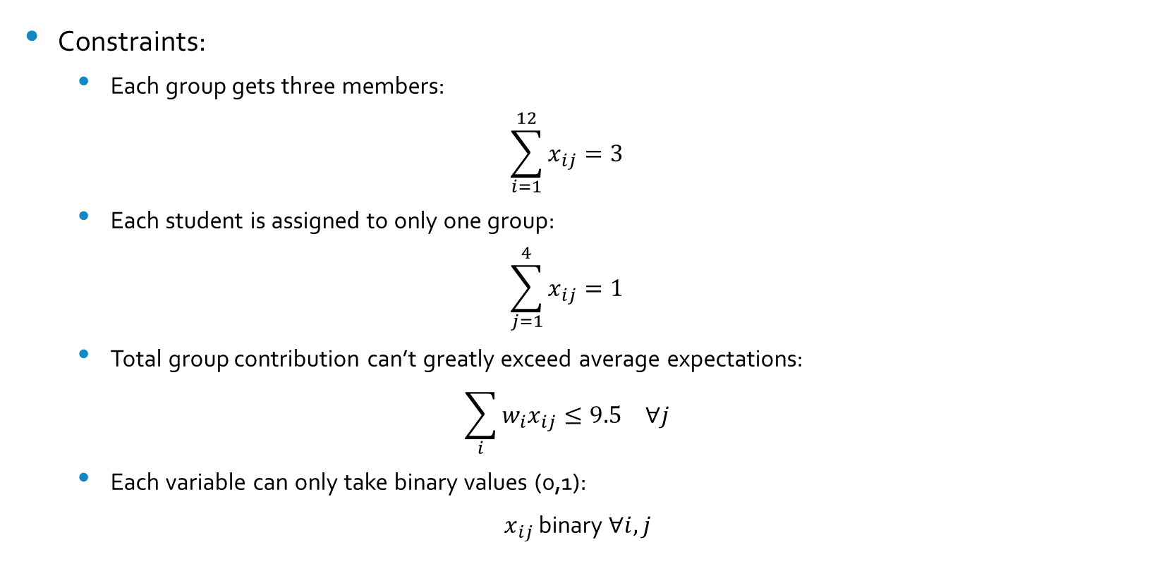
Formulation
Constraints:
Each group gets three members:
$$\sum_{i=1}^{12}{x_{ij}}=3$$
Each student is assigned to only one group:
$$\sum_{j=1}^{4}{x_{ij}}=1$$
Total group contribution can’t greatly exceed average expectations:
$$\sum_{i}{w_{i}x_{ij}}≤9.5 ∀j$$
Each variable can only take binary values (0,1):
$x_{ij}$ binary $∀i,j$

Slide 7
Student Data
 | GPA | Experience | Work Hrs | Expected Contribution |  | GPA | Experience | Work Hrs | Expected Contribution
Student 1 | 3.2 | 0 | 15 | 2.6 | Student 7 | 3.5 | 8 | 50 | 5.5
Student 2 | 2.7 | 2 | 20 | 2.9 | Student 8 | 2.9 | 0 | 0 | 2.9
Student 3 | 3.8 | 0 | 25 | 2.8 | Student 9 | 2.7 | 0 | 30 | 1.5
Student 4 | 3.0 | 0 | 0 | 3 | Student 10 | 3.2 | 3 | 20 | 3.9
Student 5 | 2.3 | 5 | 40 | 3.2 | Student 11 | 3.0 | 1 | 20 | 2.7
Student 6 | 4.0 | 0 | 0 | 4 | Student 12 | 2.5 | 0 | 10 | 2.1

Slide 8
Results
Group 1 |  |  |  |  | Group 3
 | GPA | Experience | Work Hrs | Contribution |  | GPA | Experience | Work Hrs | Contribution
Student 4 | 3.0 | 0 | 0 | 3 | Student 1 | 3.2 | 0 | 15 | 2.6
Student 5 | 2.3 | 5 | 40 | 3.2 | Student 2 | 2.7 | 2 | 20 | 2.9
Student 8 | 2.9 | 0 | 0 | 2.9 | Student 6 | 4.0 | 0 | 0 | 4
Group 2 |  |  |  |  | Group 4
 | GPA | Experience | Work Hrs | Contribution |  | GPA | Experience | Work Hrs | Contribution
Student 7 | 3.5 | 8 | 50 | 5.5 | Student 3 | 3.8 | 0 | 25 | 2.8
Student 9 | 2.7 | 0 | 30 | 1.5 | Student 10 | 3.2 | 3 | 20 | 3.9
Student 12 | 2.5 | 0 | 10 | 2.1 | Student 11 | 3.0 | 1 | 20 | 2.7

